Slide 1
Mini Project-Policy Endorsement

Slide 2

Team Members
Abhinav Acharya-
Nikhil Rupainwar(POC)-161770
Prachi Nahata-161568
Rashmi Wani-161616
Sai Priya-161265
Tushar Pathak- 161697

Slide 3
Project Details
Policy Endorsement System is basically a Insurance policy management system that is able to complete the following task:
Customer and Admin both can login into the application.
Customer can view his basic personal details and will be able to update those details by submitting documents regarding to the change.
After submitting the documents for the updation process, request will be sent to the Admin and he will decide whether that document is valid or not and then he/she will approve or reject that request.
Customer can search for a specific policy by his/her Name or ID, Date of Birth and the Policy Number.
The work of Admin in this application is to approve or reject the request raised by the customer. And the Admin can also view all the details of all of the customers that are registered in the application.

Slide 4
Abstract of the Project
An Insurance company wants to set up Online policy endorsement facility for their Customers. They sell Life and Non Life products insurance to their customers.
This Online Policy Endorsement System should provide the following features to the customers:
Search Policy
View Policy details
Update Policy details (Endorsement)
Upload supporting documents
View Endorsement status

Slide 5
Diagram Depicting Entire Project

Slide 6
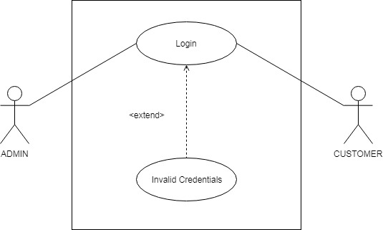
Use Case Diagram This is the use case diagram for login page where according to the login credentials and user type, the latter page is directed.

Slide 7
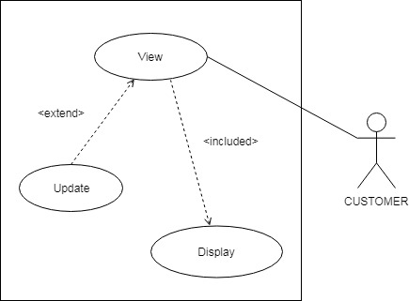
Use Case Diagram(contd…) If the login user type is customer, then his/her home page is directed which has choices like viewing the policy details or updating it.

Slide 8
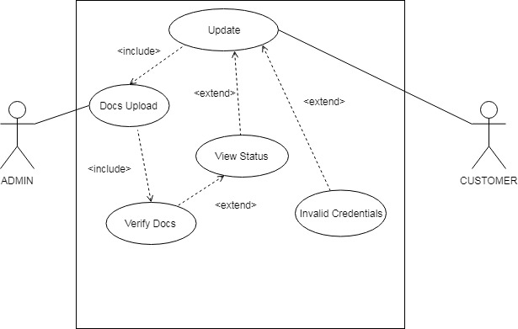
Use Case Diagram(contd…) If the Customer wants to update his/her details then he/she has to upload some valid documents regarding the updation and the Admin will decide whether the update request raised by the user is valid or not.

Slide 9
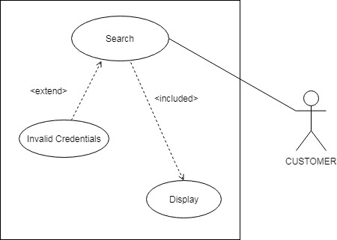
Use Case Diagram(contd…) Customer can search details of his/her policy by entering the Policy Number, Customer Name or Customer ID and Date of Birth.

Slide 10
Class Diagram

Slide 11
Sequence/Activity Diagram

Slide 12
Screen shots

Slide 13
Screen shots

Slide 14
Future Enhancements
For Future purpose we can do this Project by ASP .NET and we can add some other functionalities in the application, those are:
Customer can register themselves for a new policy.

Slide 15
Thanks

